Slide 1
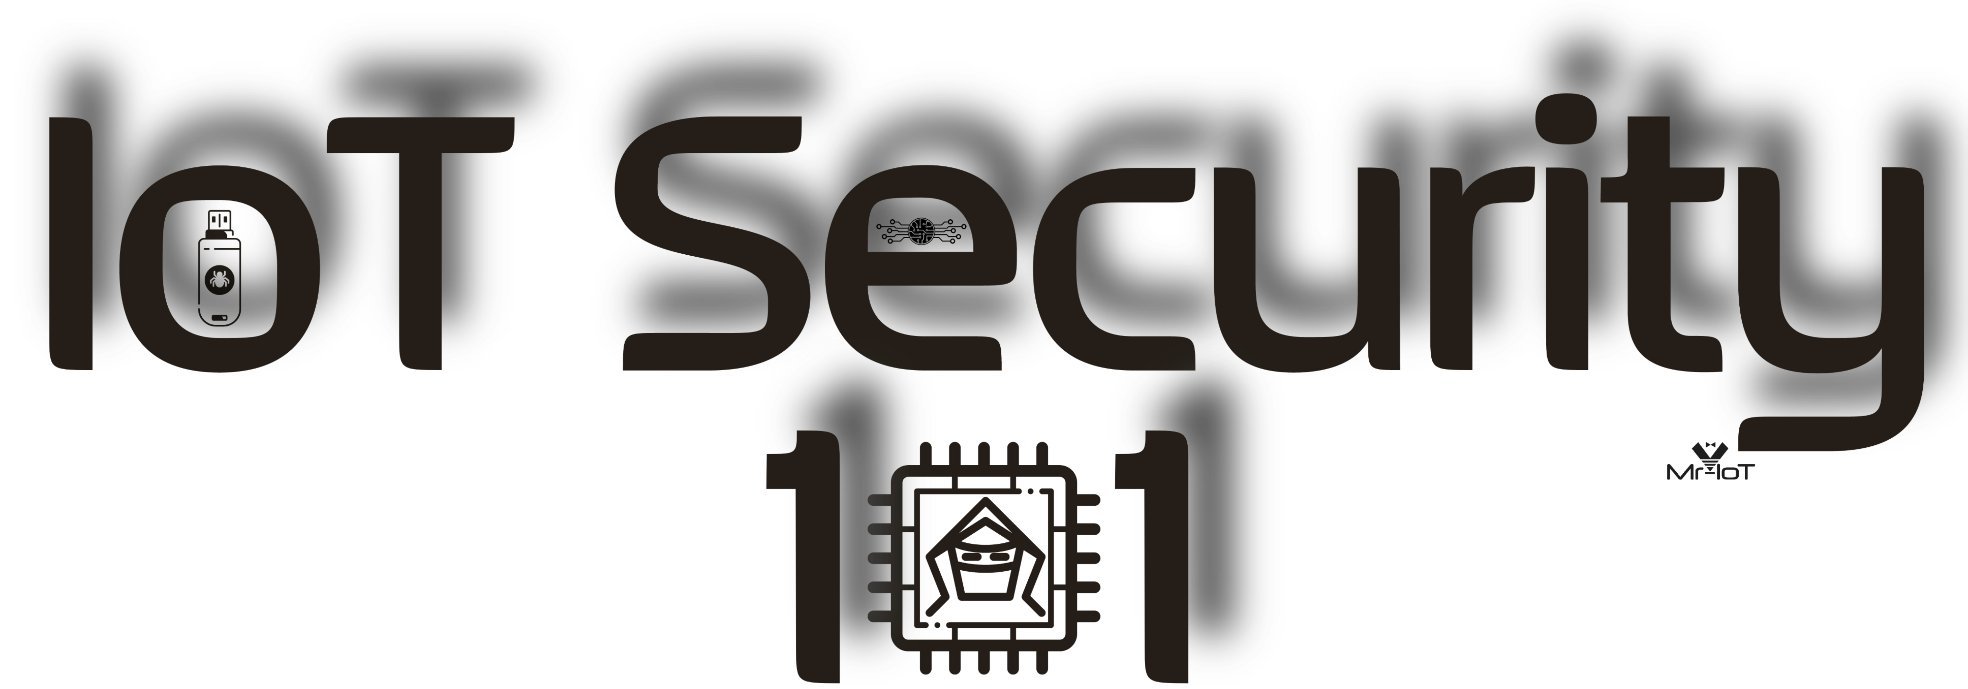
Microprobing with ICEBite
Solderless testing probes for everyone

Slide 2

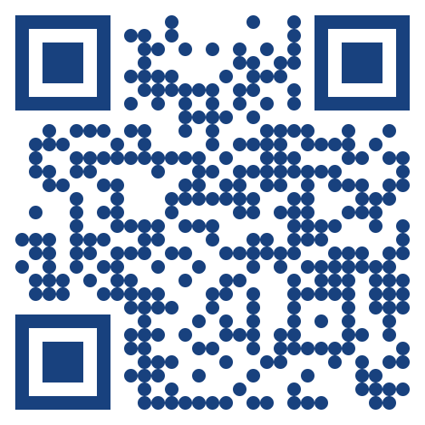
We are IoT Security 101, an open initiative in IoT security Community, known for our flagship IoT-PTv1 OS, curated content, and influential online groups; now expanding our mission through research and conference workshops and villages & new knowledge-sharing initiatives

Slide 3
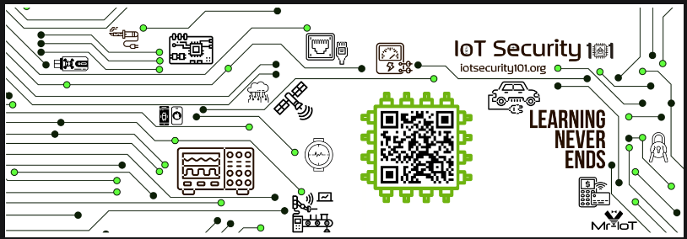
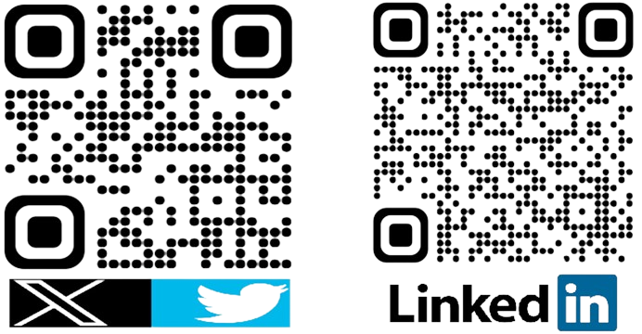
About Me..!
Lead QE Engineer at Crestron Software Development India Pvt Ltd.
Soldering, PCB analyst and Lock picking expert.
Core team member of IoTSecurity101

Slide 4
Agenda..
Why Solderless testing probes
How Icebite started in India
Other similar products
Detailed explanation
Use cases
Demo
Conclusion

Slide 5

Why solderless probes..?
Reduce Impact wrong soldering like heat control and pin dis-location etc
If you are beginner zero worries on soldering
Loss of data signals controlled
Easy to use like Plug “n” Play

Slide 6
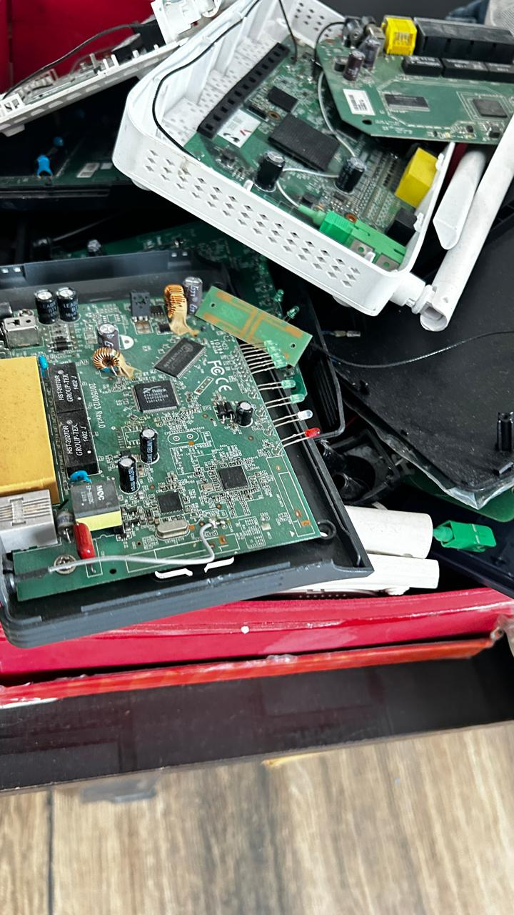
How icebite started in india
Kind of our team messed up many thing’s teardowns and soldering and pads got damaged
We have tested some expensive gadgets like bitcoin wallets single units so difficult to solder them
Based on the above experiences we decided start in INDIA making instead importing , customs charges increased
Ofcourse we have taken inspiration from pcbite and pizzabite

Slide 7
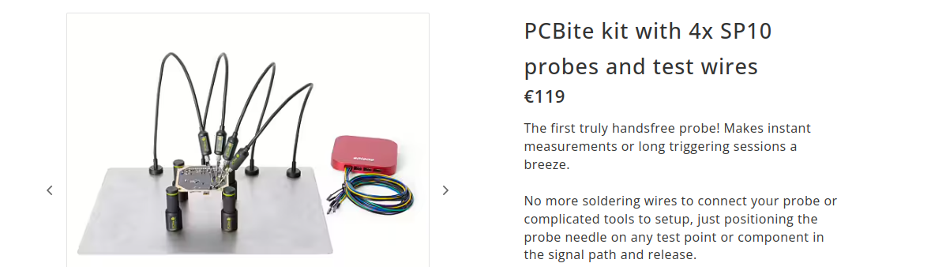
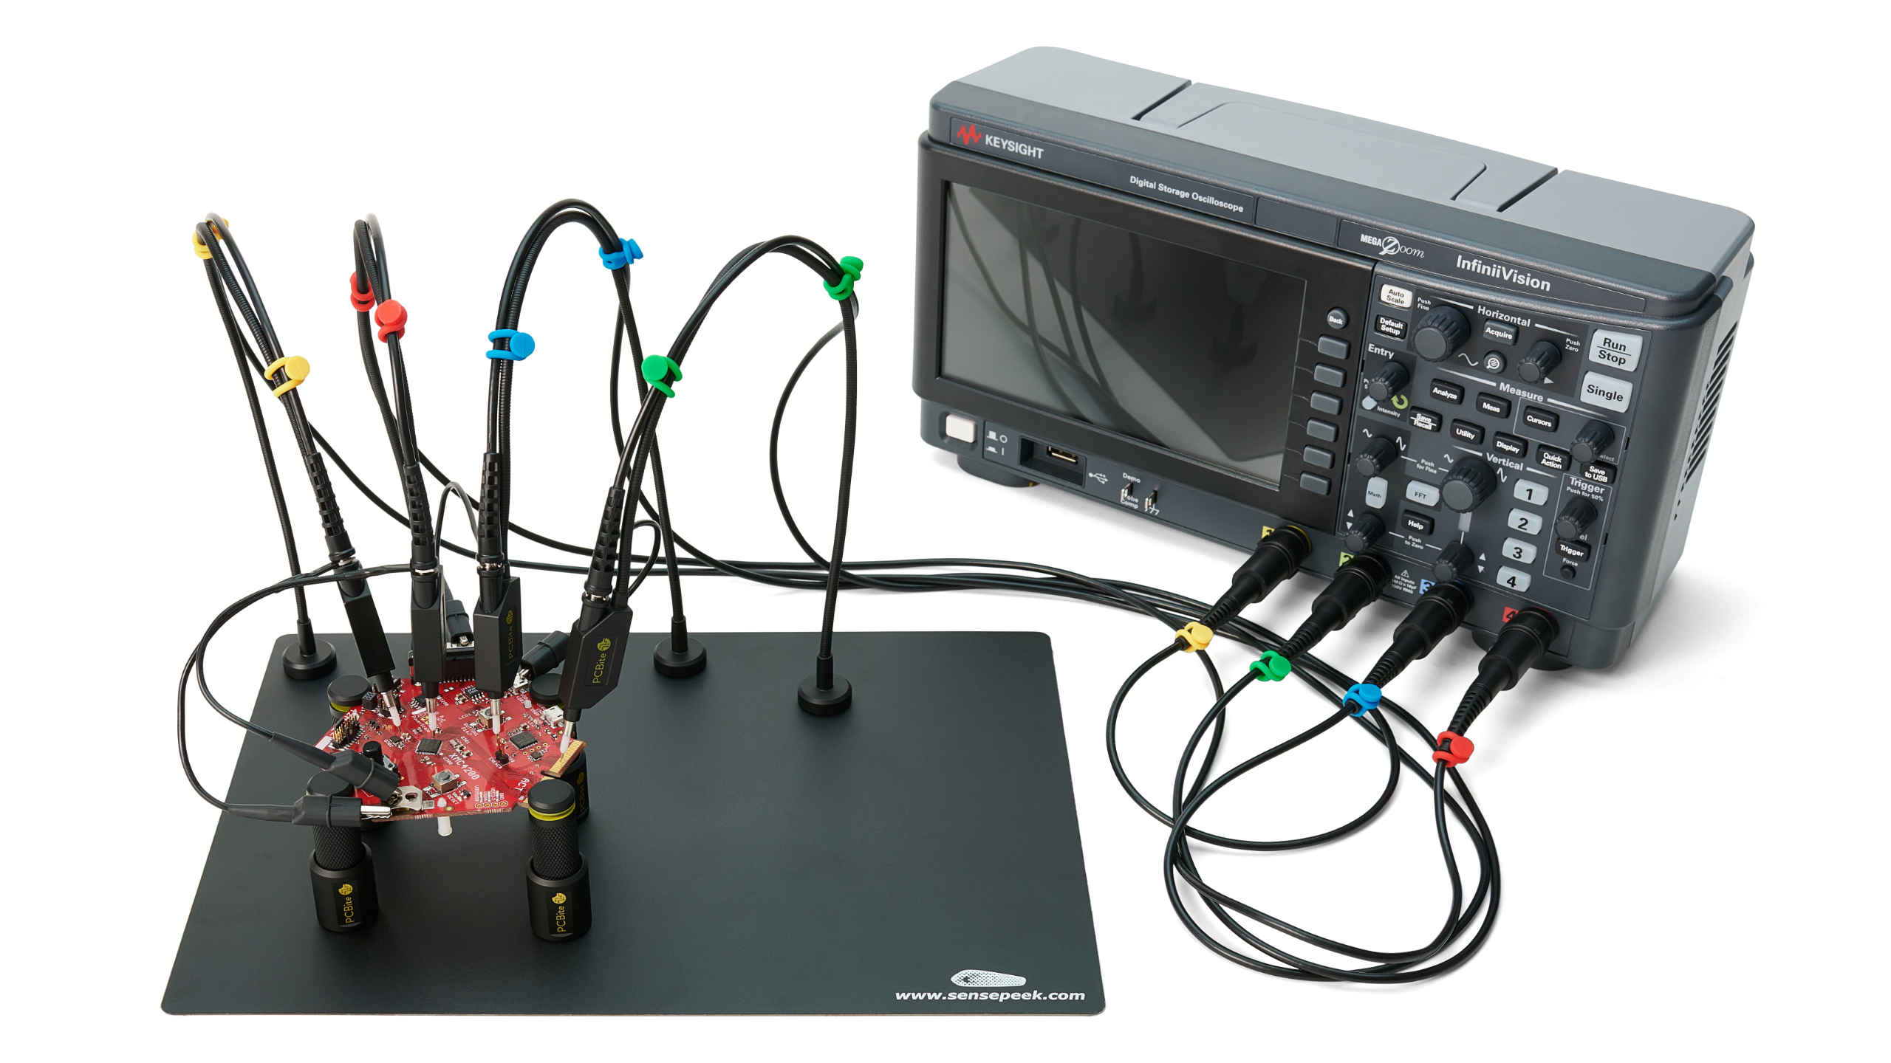
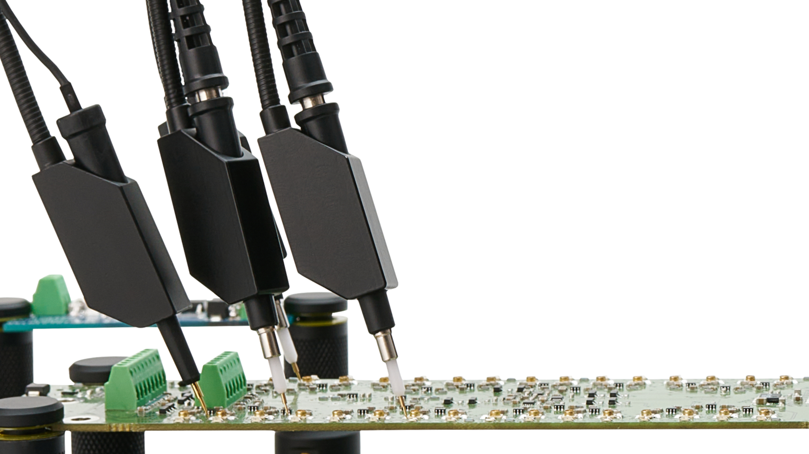
Other similar products
PCBite by sensepeek

Slide 8
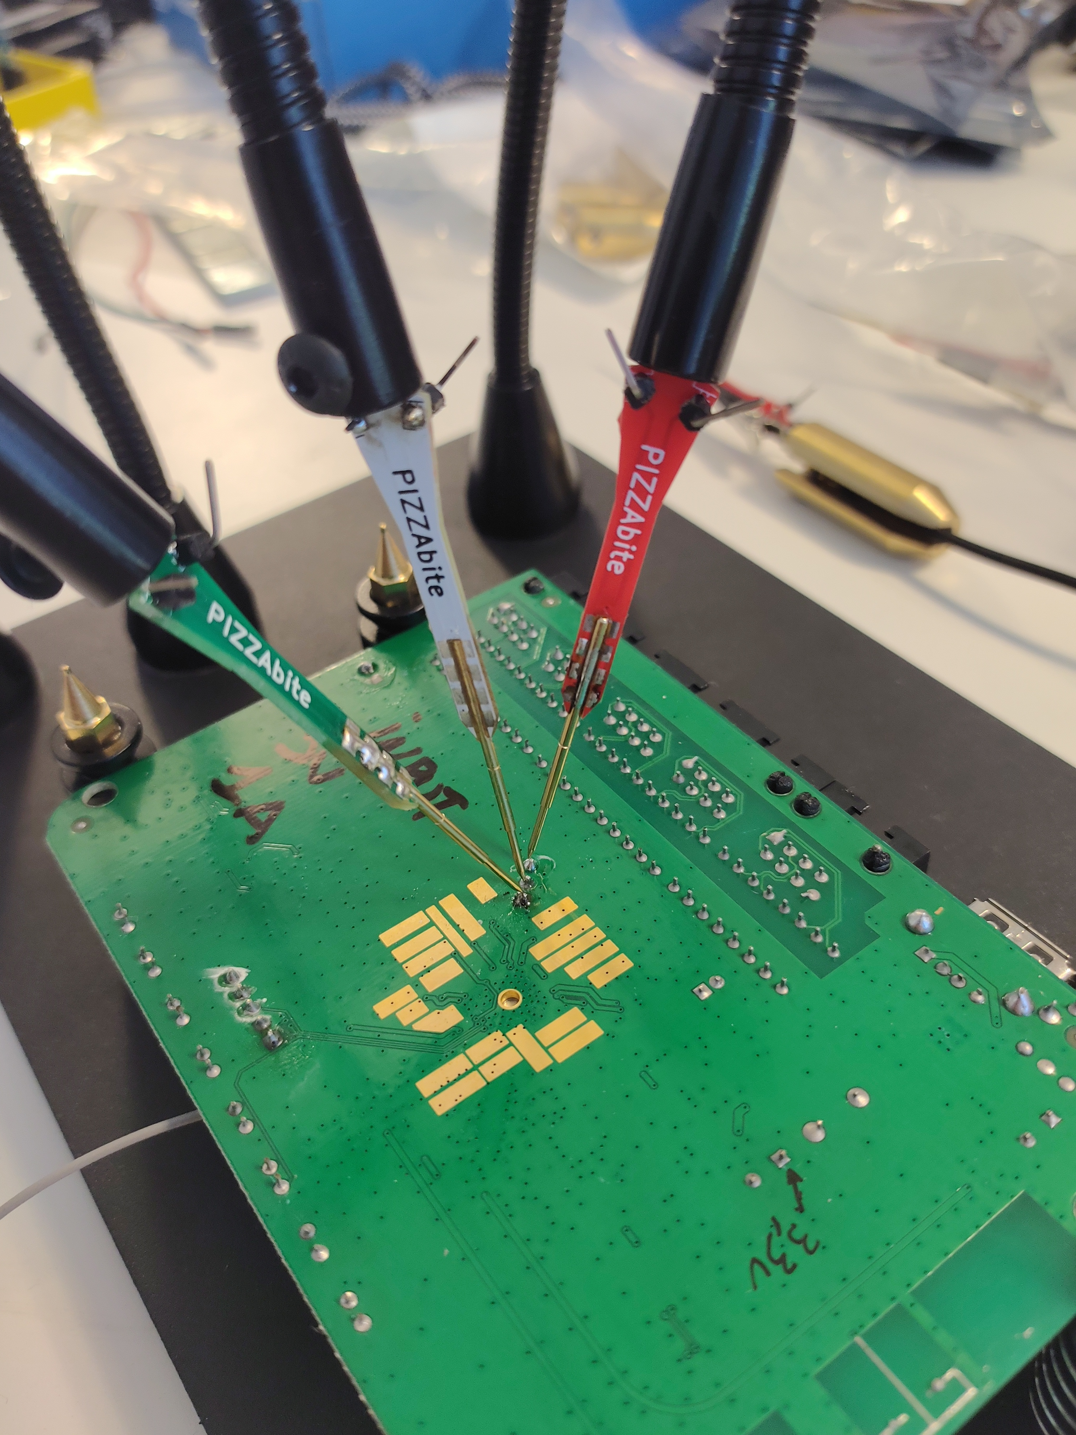
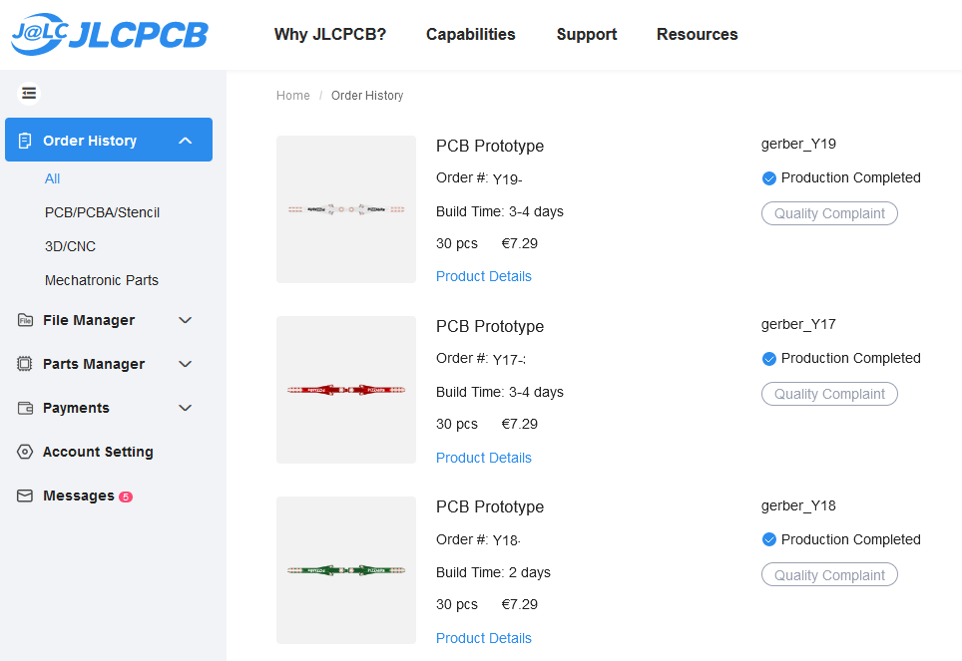
Other similar products
Pizzabite by whid team

Slide 9
Detailed explanation
Icebite includes following
Spring Pogopins with dia 1.36 or 1.38 mm we can use
PCB design
Soldering Flexible or helping hands
Target PCB holder for stability
Good base for icebite holder with crocodile clamps

Slide 10
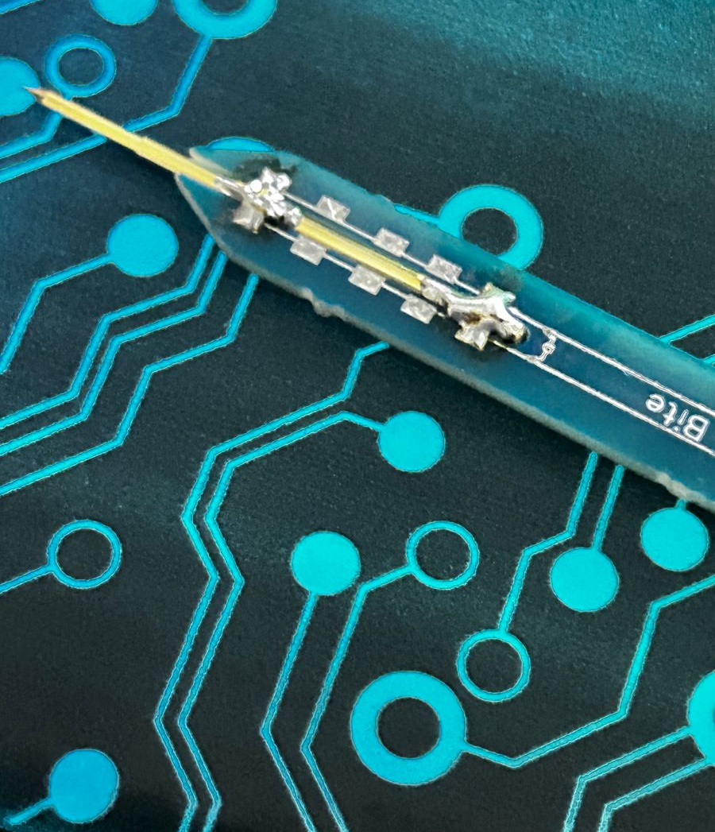
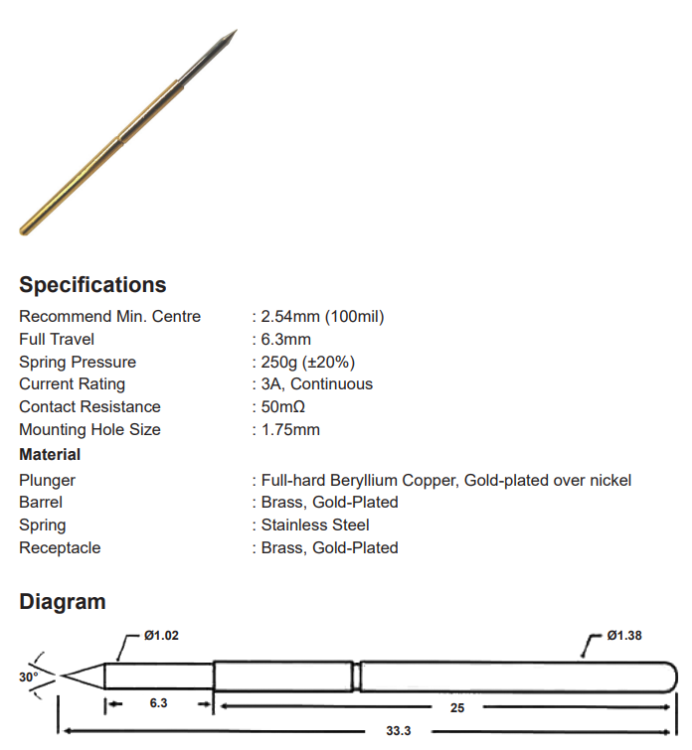
Pogo pins
Spring Pogopins with dia 1.36 or 1.38 mm we can use

Slide 12
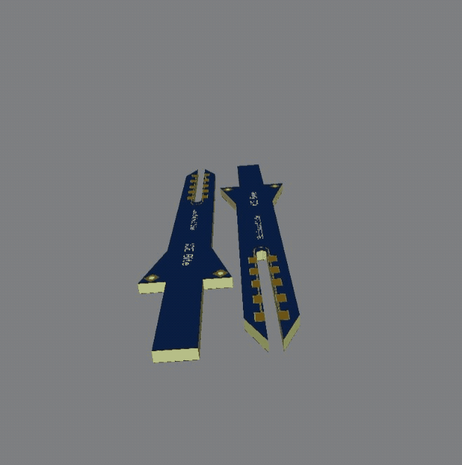
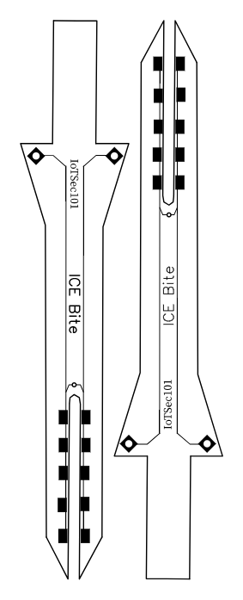
PCB Design:

Slide 13
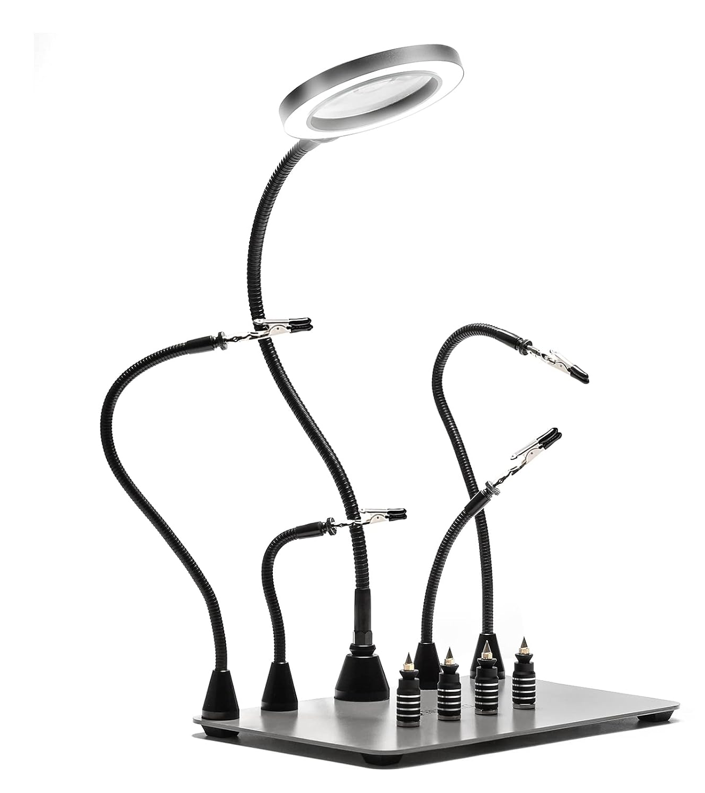
Soldering Flexible or helping hands:
Rupees : 18,191 INR

Slide 14
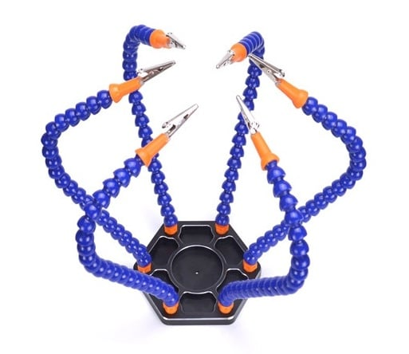
Soldering Flexible or helping hands:
We choose this for 1400Rs

Slide 15
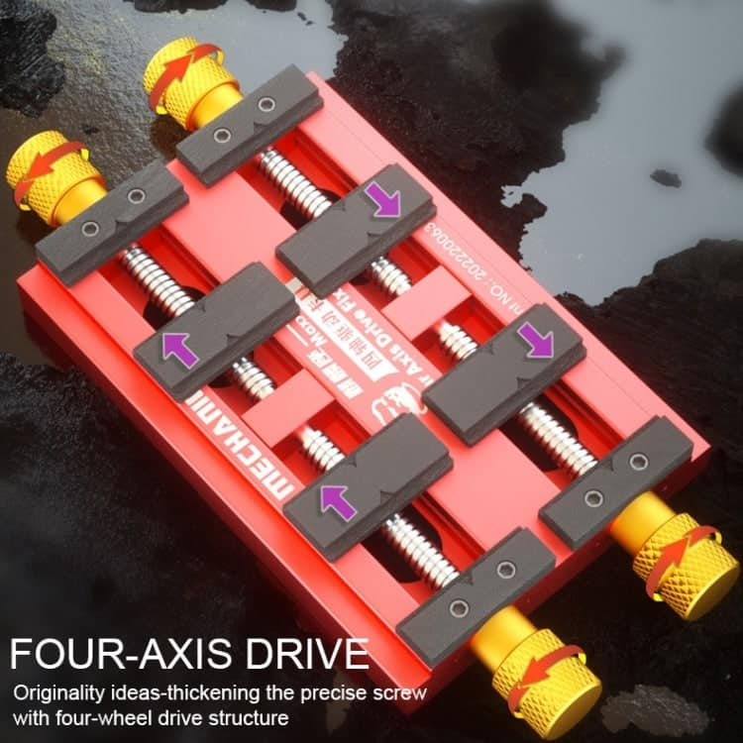
PCB Holder:

Slide 16
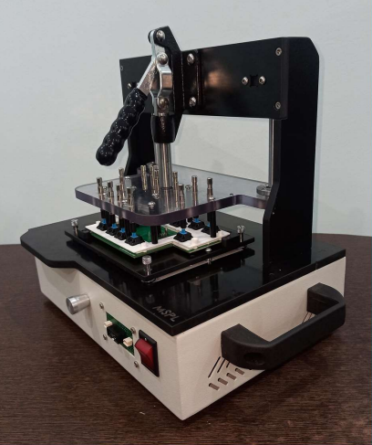
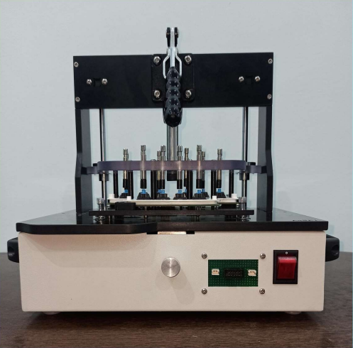
PCB Holder:

Slide 17
Use cases:
Fixture Desing & Manufacturing:
Manual Testing Fixture (Toggle Mechanism)
Pneumatic Testing Fixture (Cylinder Mechanism)
Cam-operated test fixtures for RF, circuit, and jacking, as well as automation solutions.
This can be used in produce various sorts of standard test setups, such as Customized design and furniture accessories.

Slide 18
Use cases:
Avoid soldering on sensitive chips
Probing UART pins without tampering and damaging PCAB
Probing JTAG Pins
Retaining the device in its original shape.
Avoid soldering issues Cold joins, Solder bridging, Excess soldering, Insufficient soldering , In-correct soldiering temperature.

Slide 19
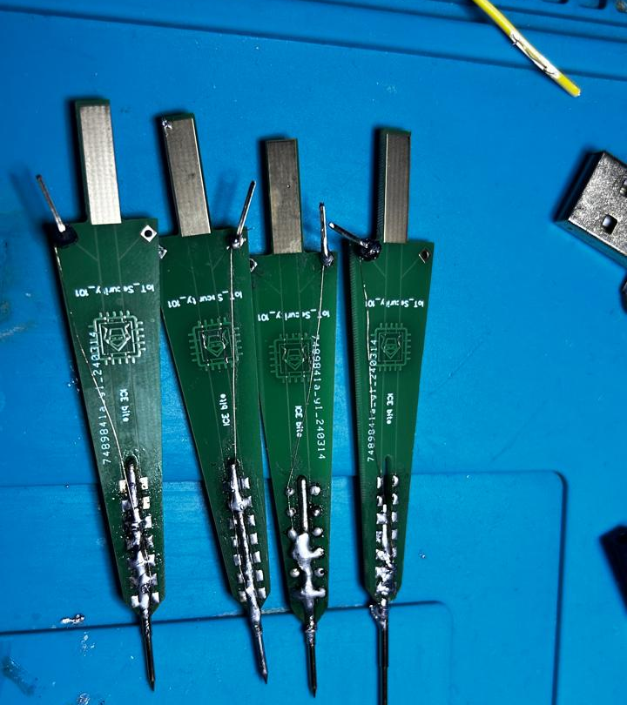
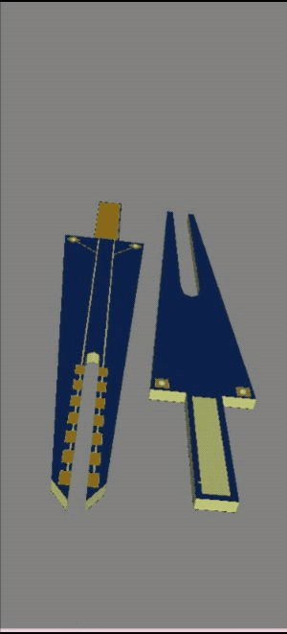
Alpha version 1st failure..!

Slide 20
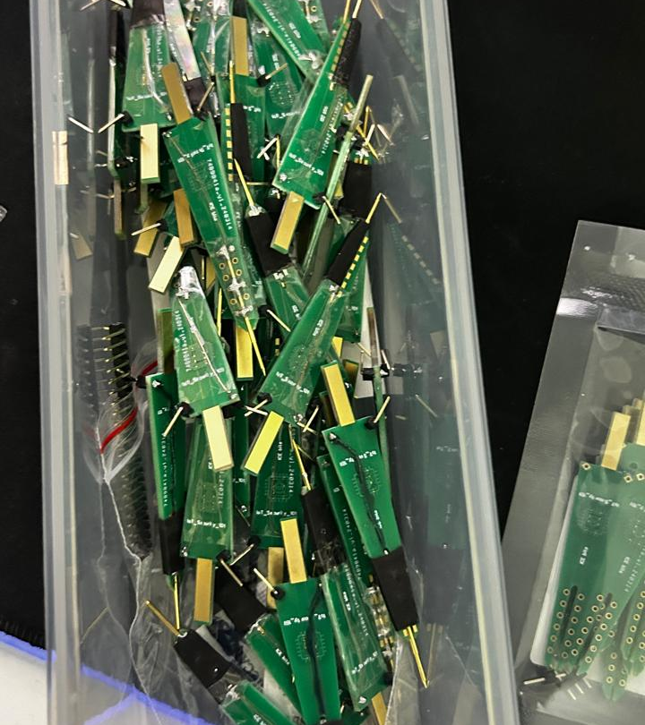
1st model bulk

Slide 21
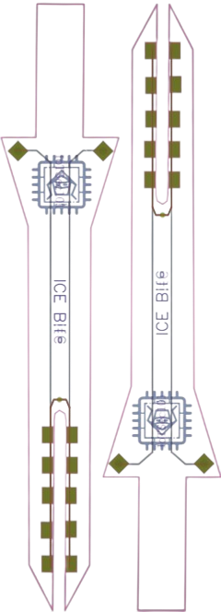
Final Design:

Slide 22
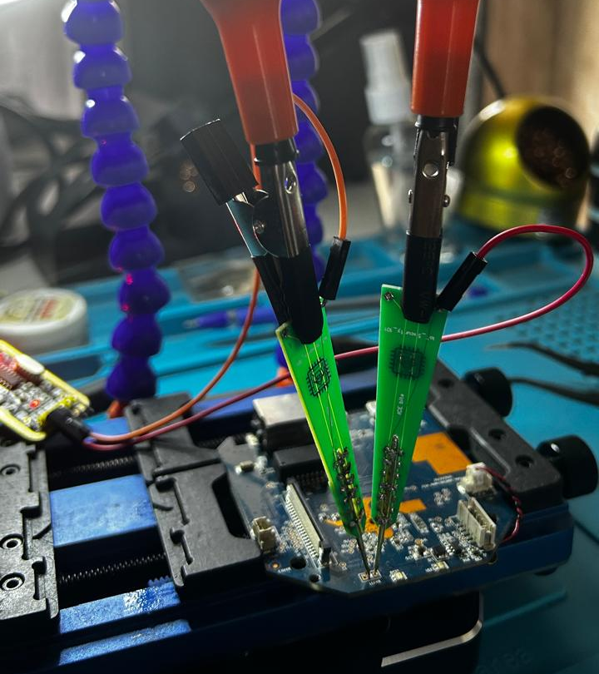
IP Camera .. Pins

Slide 23
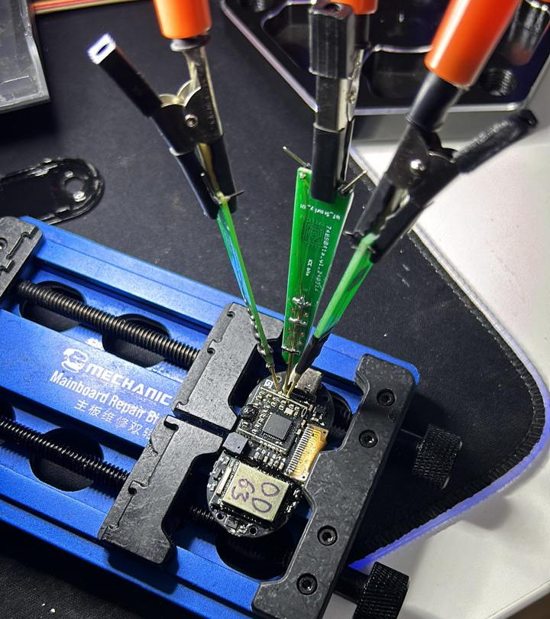
Bitcoin Wallet

Slide 24
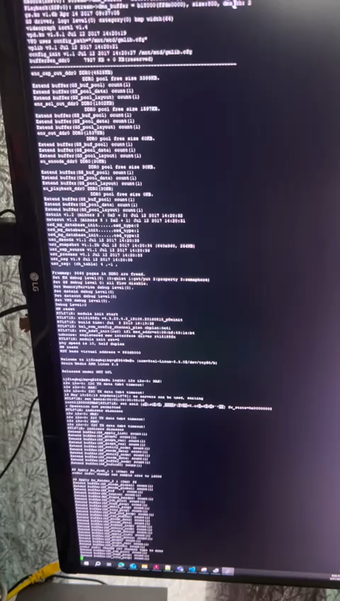
Demo

Slide 25
Conclusion:
Easy To use to Probe pin for HW Pen testing
Game changer on handling the device.
ICEBite going to be open product design anybody can print it

